Slide 1
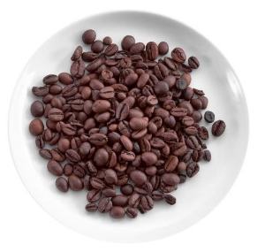
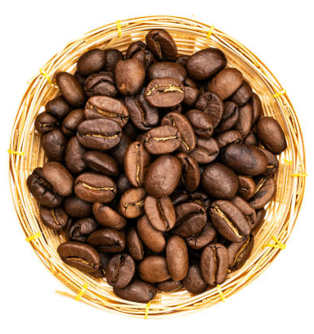
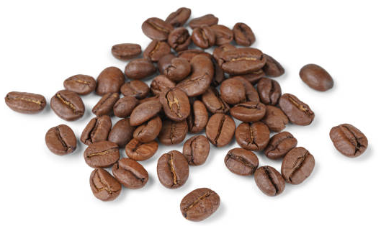
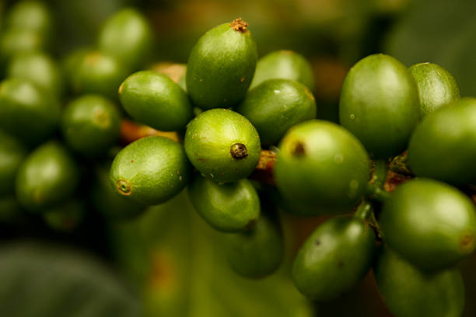
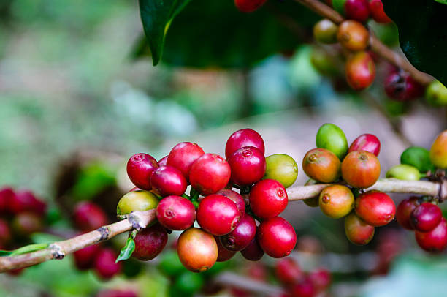
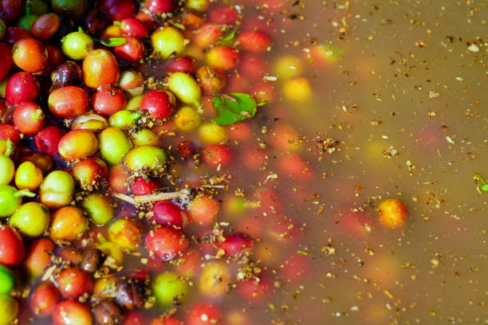
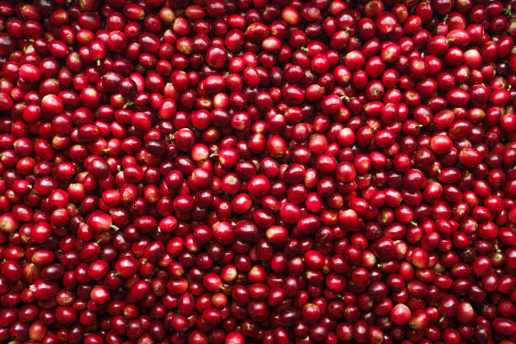
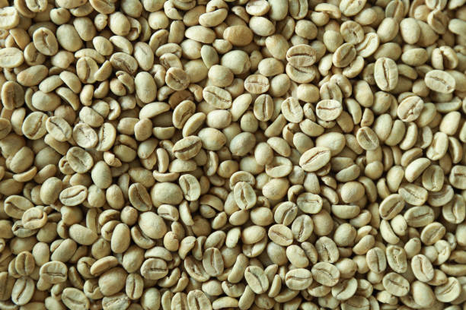
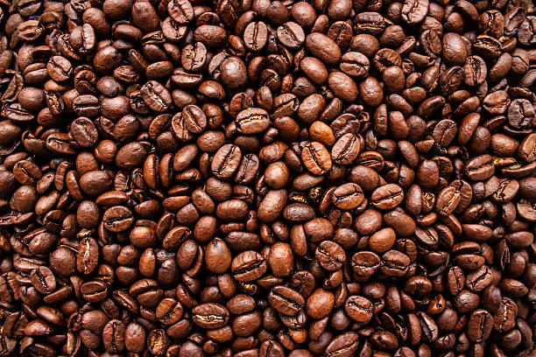
Vietnam America Agriculture Products Export Company Limited
CATALOGUE

Slide 2
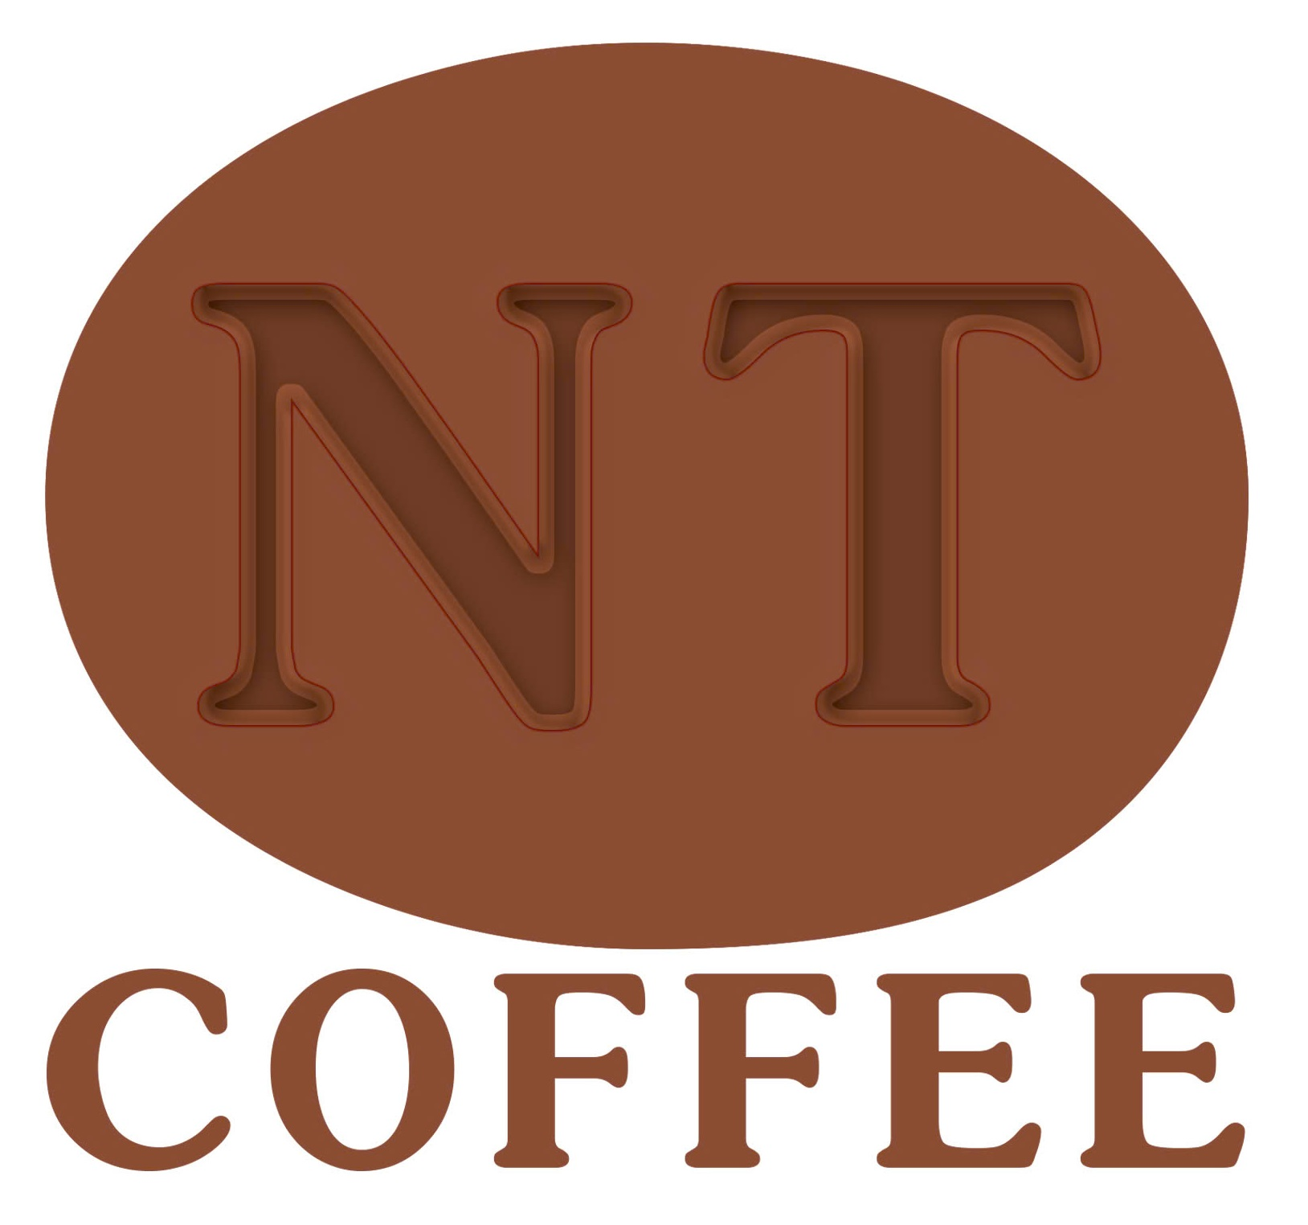
Product Catalogue - Coffee
Vietnam America Agriculture Products Export Company Limited
Pure clean coffee
Address:
E-mail
Contact
Ho Chi Minh Office: 01 Nguyen Thong Street, 3 District, Ho Chí Minh City, Viet Nam.
Ha Noi Office: 01 Trần Quý Cáp Street, Đống Đa District, Hà Nội, Việt Nam.
hieu@nguyentoanvn.com
kinhdoanh01@nguyentoanvn.com
Website: www.nguyentoanvn.com
Zalo, Whatsapp, Viber, Linkedin, Wechat
Tel: +84-906 147 000
+84-906 775 932

Slide 3
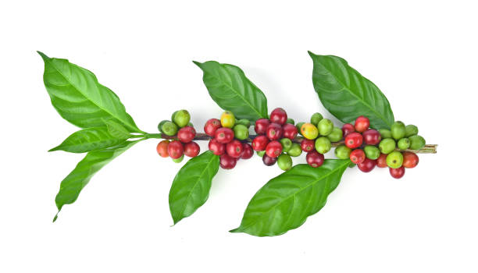
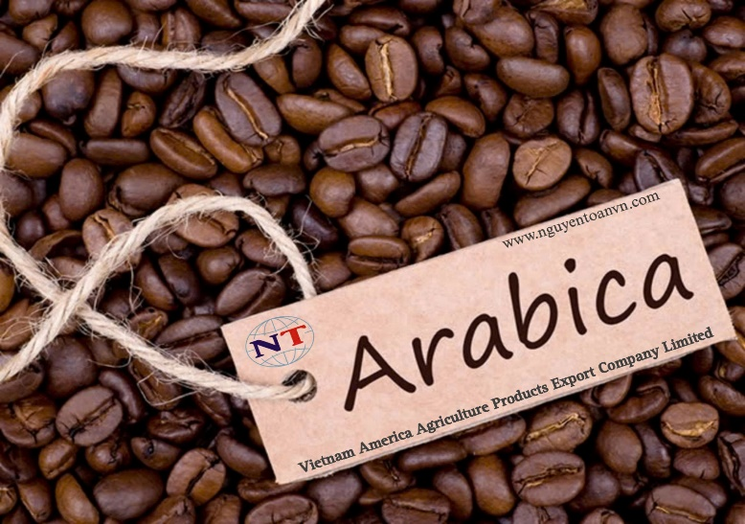
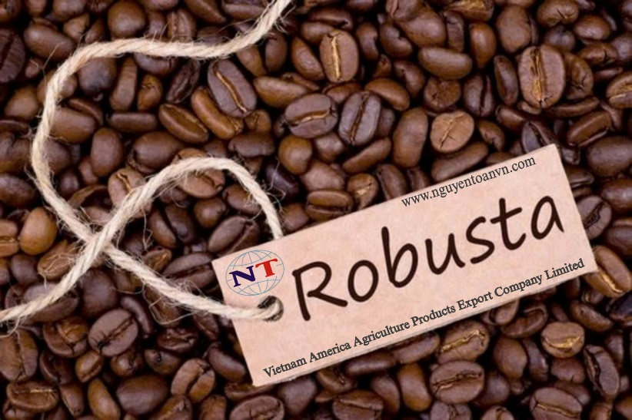
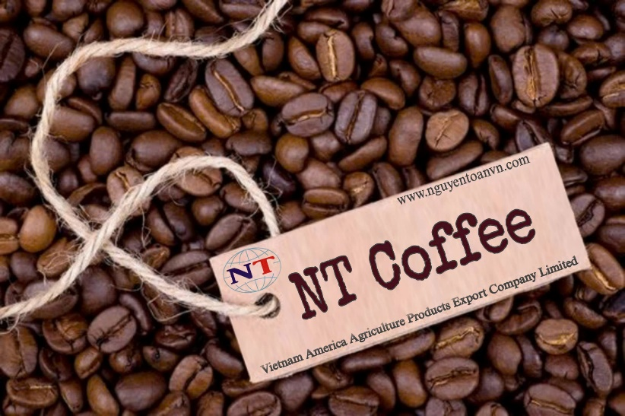
Menu products of the company
Arabica
Robusta
NT Coffee
Moisture: 3.71% ;
Caffeine: >= 1.58%
Aflatoxin: Not Detected
E. Coli: < 10 CFU/g
Enterobacteriaceae: <10 CFU/g
Total Yeast and Molds: < 10 CFU/g
Packaging: 1kg/bag; 50kg/bag
PH (H+): 5.0 - +-0.2
Size: S.16/S.18, No Butter
Shelf Life: 18 months
Produced in Vietnam
Moisture: 12.5% max
Caffeine: >= 1.2%
Aflatoxin: Not Detected (ppb)
E. Coli: < 10 CFU/g
Enterobacteriaceae: <10 CFU/g
Total Yeast and Molds: < 10 CFU/g
Packaging: 1kg/bag; 50kg/bag
PH (H+): 5.0 - +-0.2
Size: S.16/S.18, No Butter
Shelf Life: 18 months
Produced in Vietnam
Moisture: 9.5% max
Caffeine: >= 1.3%
Aflatoxin: Not Detected (ppb)
E. Coli: < 10 CFU/g
Enterobacteriaceae: <10 CFU/g
Total Yeast and Molds: < 10 CFU/g
Packaging: 1kg/bag; 50kg/bag
PH (H+): 5.0 - +-0.2
Size: S.16/S.18, No Butter
Shelf Life: 18 months
Produced in Vietnam

Slide 4
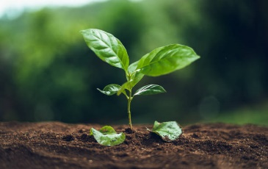
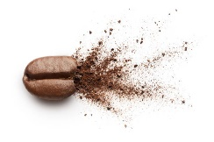
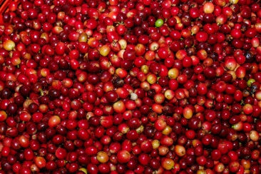
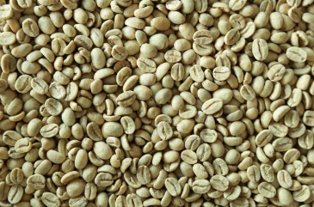
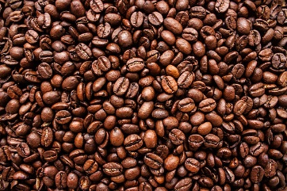
100% Roasted Arabica Coffee Beans
1. ARABICA
Arabica coffee beans, scientifically known as Coffea Arabica, primarily grow in mountainous regions at altitudes ranging from 1,000 to 1,500 meters. Their distinguishing features include a large canopy, oval shape, and dark green leaves (similar to the Vietnamese tea plant). The height of a mature tree can reach up to 6 meters or even as tall as 15 meters
The best regions for growing high-quality Arabica coffee in Vietnam include Lam Dong, Quang Tri, Dien Bien, and Son La. In particular, Lam Dong and Da Lat benefit from favorable natural conditions, making Arabica coffee from Lam Dong of exceptionally high quality, earning it the title of the 'Queen of Vietnamese Coffee

Slide 5
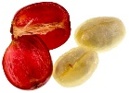
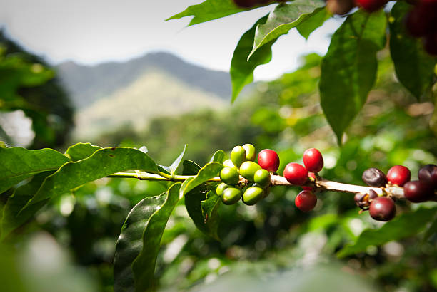
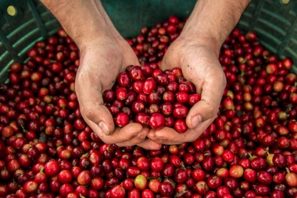
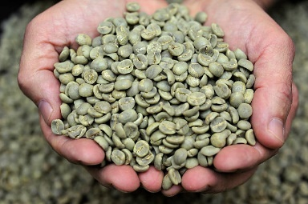
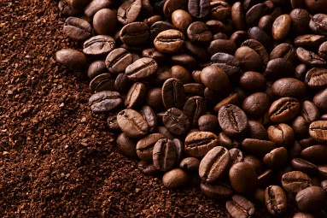
100% Roasted Robusta Coffee Beans
2. ROBUSTA
The Robusta coffee, scientifically known as Coffea robusta or also called 'cà phê Vối' in Vietnamese, contains a caffeine content ranging from 2% to 4%. It has a stronger taste, and its beans are rounder and smaller than Arabica coffee beans. In fact, Robusta is a relatively recently discovered coffee variety and quickly became widely cultivated in many countries due to its ease of care, easy cultivation, and high resistance to pests and diseases
Robusta coffee thrives in tropical regions, with an ideal growing altitude of below 1,000 meters. The preferred temperature for the plant is around 24-29°C, and it requires rainfall of over 1,000 mm. Robusta coffee plants need more sunlight compared to Arabica coffee plants.

Slide 6
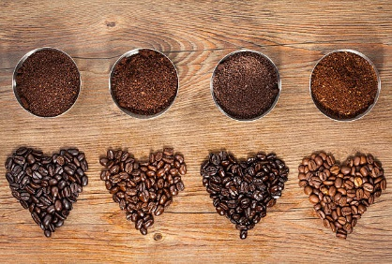
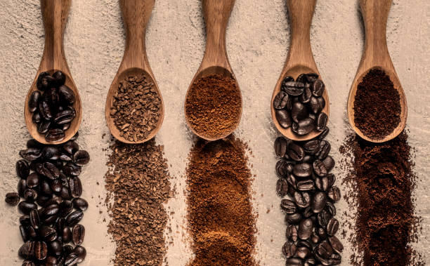
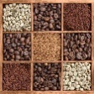
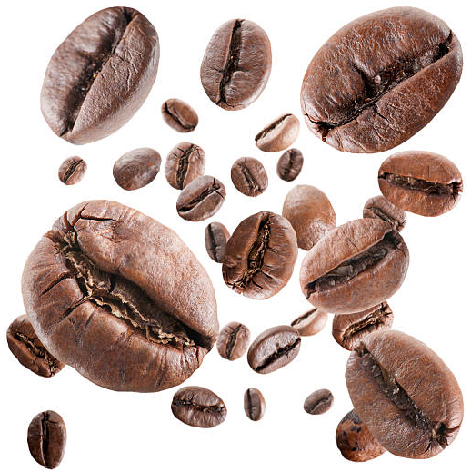
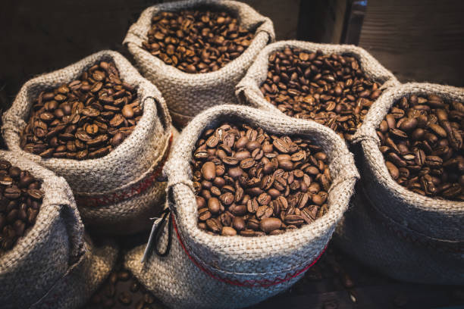
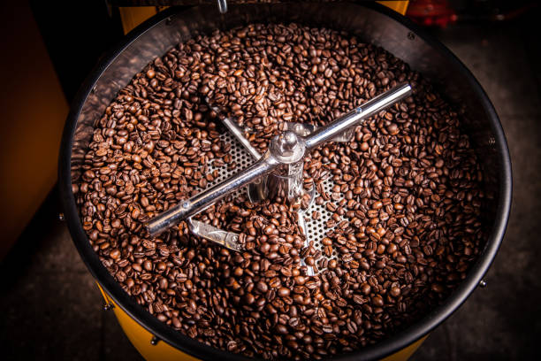
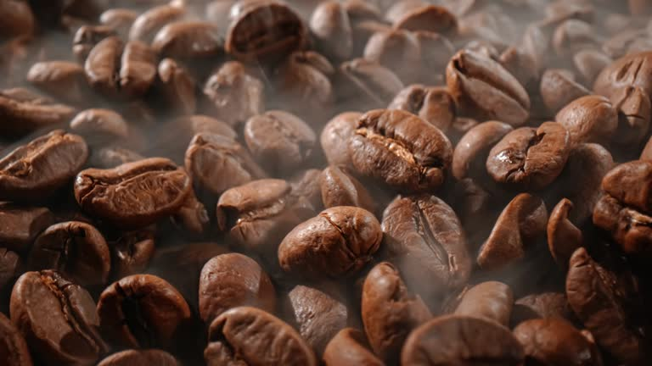
NT Coffee Beans
3. NT Coffee
NT Coffee is a sophisticated combination of Arabica and Robusta. Robusta enhances the boldness and caffeine content of the espresso, while Arabica adds a rich aroma, a mild acidity, and a gentle sweetness. This harmonious blend has gradually become the choice of many coffee lovers around the world.
NT Coffee is a special coffee product carefully selected from the finest coffee-growing regions in the world, combined with leading production technology and NT Coffee unique roasting method that cannot be replicated, delivering a captivating and rich flavor

Slide 7
THANK YOU Vietnam America Agriculture Products Export Company Limited
Address:
Contact
E-mail
Ho Chi Minh Office: 01 Nguyen Thong Street, 3 District, Ho Chi Minh City, Viet Nam.
Ha Noi Office: 01 Tran quy Cap Street, Dong Da District, Hà Nội, Việt Nam.
Website: www.nguyentoanvn.com
Zalo, Whatsapp, Viber, Linkedin, Wechat
Tel: +84-906 147 000
+84-906 775 932
hieu@nguyentoanvn.com
kinhdoanh01@nguyentoanvn.com

